Slide 1


Layered Architecture Pattern: An Overview
The Layered Architecture Pattern organizes complex applications into distinct layers, each with a specific role. This presentation explores the pattern's benefits, common layers, communication styles, and best practices, providing a comprehensive understanding of this popular architectural approach.
by Mohamed Amr

Slide 2
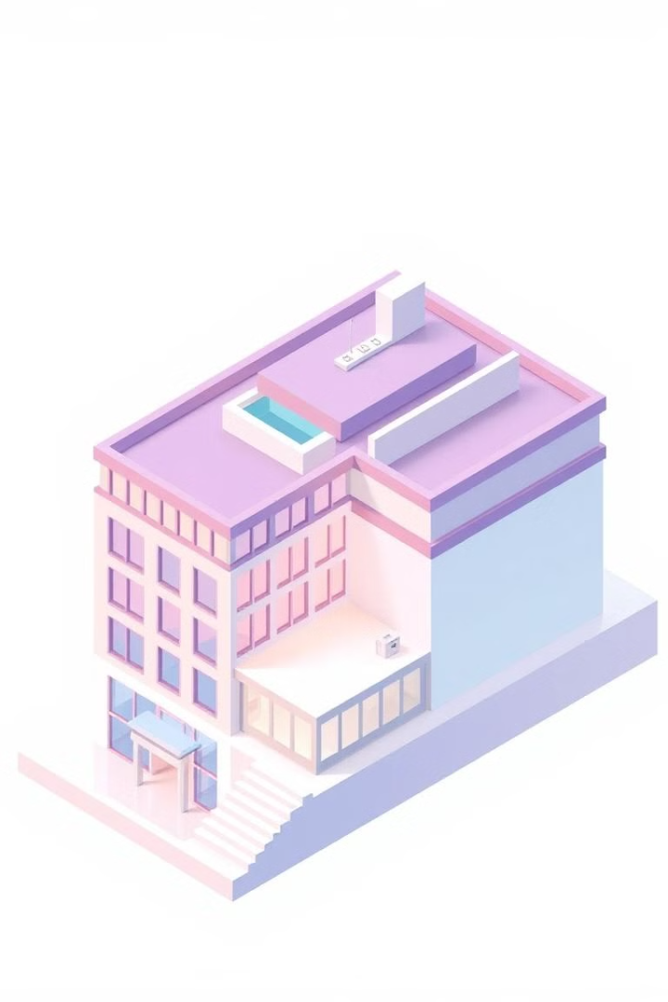
What is the Layered Architecture Pattern?
The Layered Architecture Pattern structures an application into horizontal layers. Each layer performs a specific role and resides within a hierarchy. Key principle is separation of concerns. Layers are loosely coupled, enhancing modularity. Strict Layering: Each layer can only call the layer directly below. Relaxed Layering: Layers can call any layer below. Example: Presentation, Business, Data Access.

Slide 3
Key Benefits of Layered Architecture
Modularity & separation of concerns are enhanced.
Maintainability and testability are improved.
Code reusability is increased across the application.
Clear organization and understandability.
Individual layers can be deployed and scaled independently.

Slide 4

Common Layers in Layered Architecture
Presentation Layer (UI): Handles user interactions and presents data.
Business Logic Layer: Implements business rules and workflows.
Data Access Layer: Interacts with databases or other data sources.
Persistence Layer (Optional): Maps business objects to database records.

Slide 5
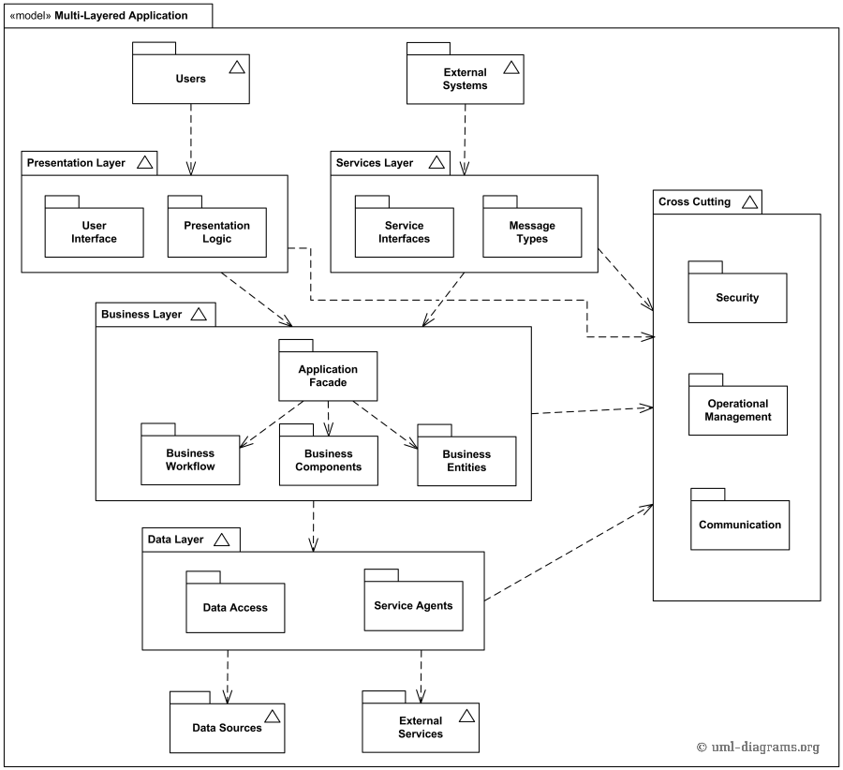

Slide 6
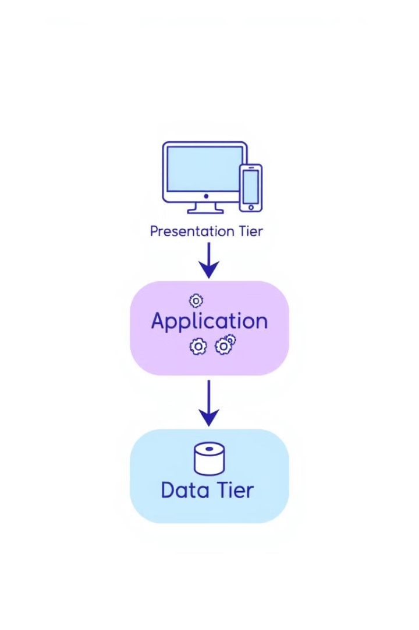
Types of Layered Architecture: Three-Tier
Presentation Tier Application Tier Data Tier Simple to implement, the three-tier architecture comprises a presentation tier, an application tier, and a data tier. It's best suited for small to medium-sized applications. However, it can become monolithic over time.

Slide 7
Three-Tier: Pros, Cons, Scenarios
Pros:
Fast development (single codebase).
Easy to deploy (one application).
Clear separation of concerns (UI, logic, data).
Cons:
Single point of failure (app server downtime).
Difficult to scale individual components.
Changes require redeployment of entire app.
Scenario: simple e-commerce site (MVP, limited functionality).
Recommended: when fast time-to-market is priority.

Slide 8
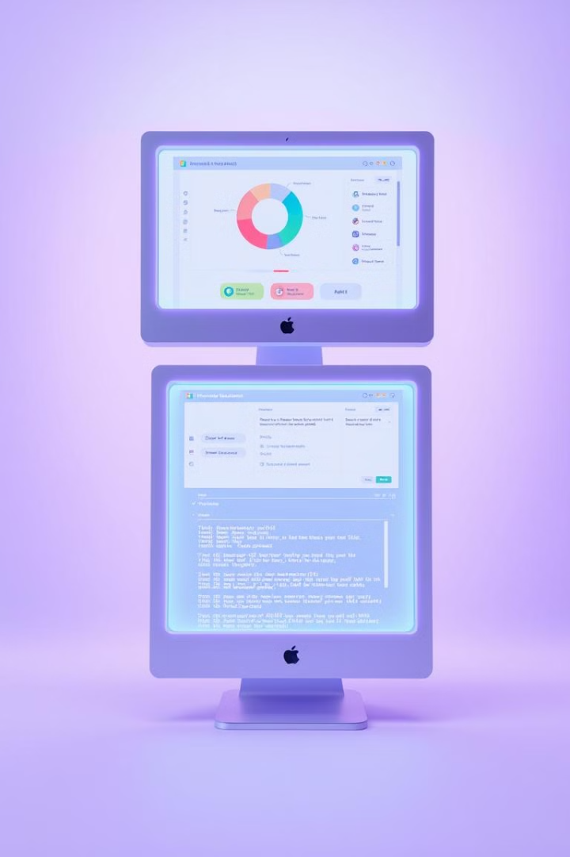
Three-Tier Architecture Example
Presentation Tier
Application Tier
React component displaying user data.
Node.js/Express API endpoint.
Data Tier
MongoDB storing user data.
Communication is synchronous using a request-response model.

Slide 9
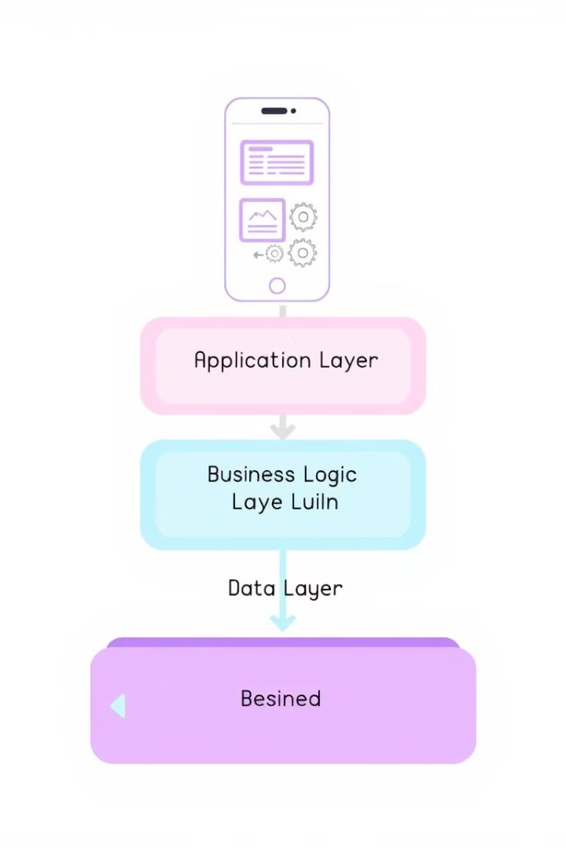
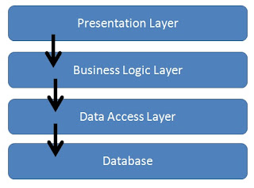
Types of Layered Architecture: Four-Tier Architecture
Presentation Tier Application Tier Business Tier Data Tier Four-Tier Architecture offers a greater separation of concerns. It includes a Presentation, Application, Business, and Data tier. This enhances scalability and maintainability but introduces more complexity.

Slide 10
Four-Tier: Pros, Cons, Scenarios
Pros:
Improved scalability (separate application/logic layers).
Enhanced security (dedicated business logic layer).
Easier maintenance (modular design).
Cons:
Increased complexity (multiple layers and codebases).
Higher development cost (specialized expertise required).
Risk of over-engineering (unnecessary complexity for simple apps).
Scenario: complex banking application (high scalability, security).
Recommended: when application is large and requires high level of security.

Slide 11








Four-Tier Architecture Example
Presentation
Application
React component for product data.
Node.js/Express API endpoint.
Infrastructure
Domain
Database access and services.
Product business rules.

Slide 12
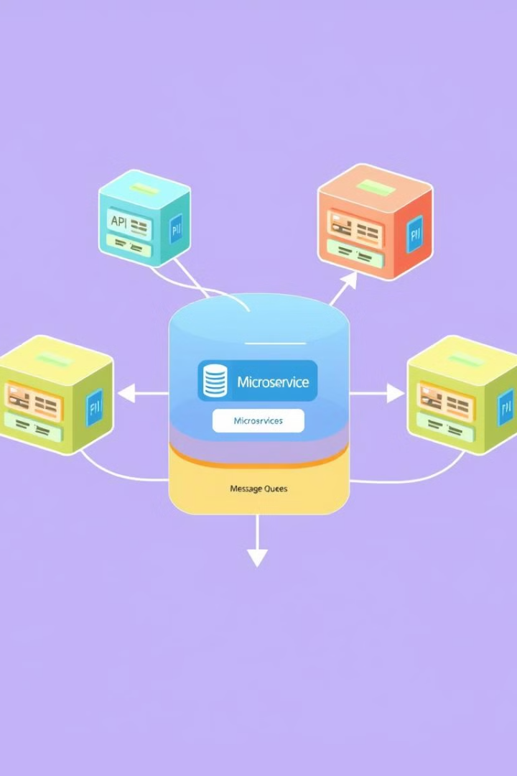
Types of Layered Architecture: Microservices (Hybrid)
Each microservice follows layered architecture internally. This allows for individual deployment and scalability. Examples include Authentication Service, Product Catalog Service. Significant architectural complexity is introduced.

Slide 13
Microservices with Layered Architecture: Pros, Cons, Scenarios
Pros:
Highly scalable (independent deployment of services).
Increased resilience (failure isolation).
Technology diversity (different stacks for each service).
Cons:
Increased complexity (distributed system management).
DevOps expertise required (containerization, orchestration).
Potential data inconsistency (distributed databases).
Scenario: Netflix-style streaming platform (huge scale, continuous updates).
Recommended: when you have a team of experts to handle scaling.

Slide 14

When to Use Layered Architecture
Three-Tier: simple web applications, quick development needed
Four-Tier: complex enterprise applications, scalability and security are critical
Microservices: large-scale systems, independent scaling and deployment are essential

Slide 15
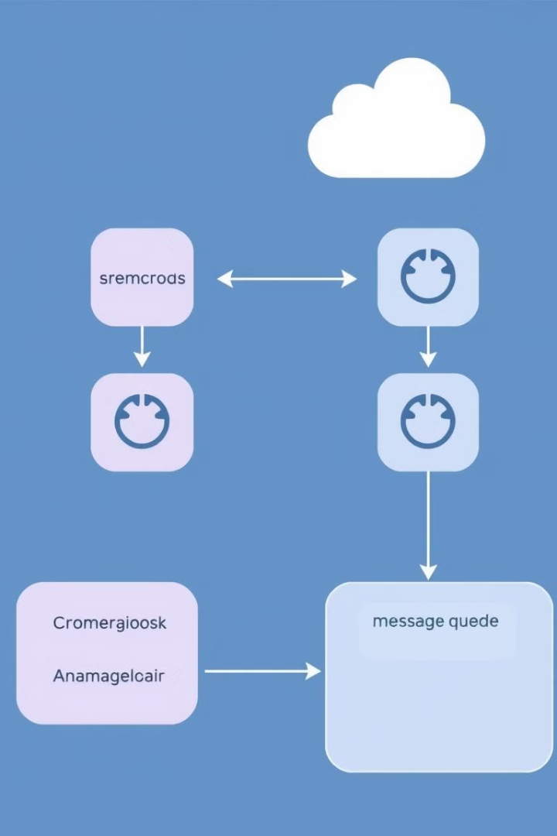
Communication Between Layers
Synchronous: Uses direct calls (blocking). Examples: HTTP requests.
Asynchronous: Employs message queues (non-blocking). Examples: Apache Kafka. Trade-offs involve performance, reliability, and complexity. Choose the appropriate communication method based on the specific layer interactions.

Slide 16
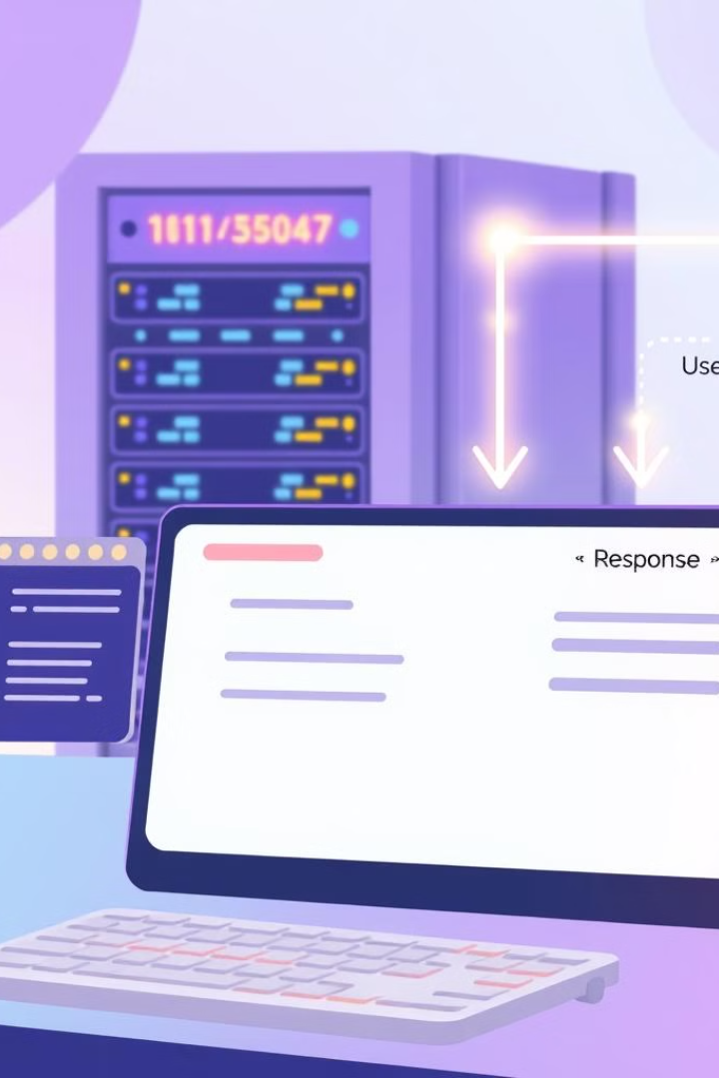
Synchronous Communication:
The Request-Response Model : Communication where the sender waits for a response from the receiver. - Mechanisms: REST APIs, GraphQL, direct function calls. - Example: A UI layer calling an API to fetch data.

Slide 17
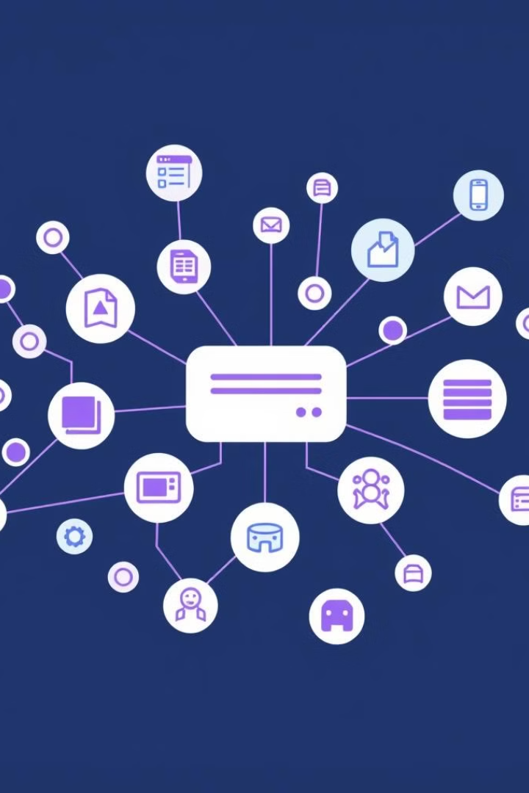
Asynchronous Communication: The Event-Driven Model - Definition: Communication where the sender doesn't wait for a response. - Mechanisms: Message queues (Kafka, RabbitMQ), WebSockets. - Example: Microservices communicating via message queues.

Slide 18




The Sinkhole Anti-Pattern
What is it?
The Problem
A layer simply passes requests to the next layer without adding value.
It reduces performance and increases complexity with no benefit.
Example
A controller directly calls a database query without logic.

Slide 19





Avoiding the Sinkhole
Add Value
Apply business logic in each layer.
Avoid Unnecessary Layers
Refactor to remove redundant layers.
Optimize Data Access
Cache to reduce database load.
Monitor
Implement logging to detect behavior.

Slide 20
Best Practices for Layered Architecture
Define clear layer responsibilities.
Minimize dependencies between layers.
Implement well-defined interfaces.
Enforce layering constraints.

Slide 21

When to Use Layered Architecture?
The Layered Architecture Pattern is suitable for applications with well-defined domains. It excels in projects requiring high maintainability and scalability and is crucial where separation of concerns is essential. Not ideal for very small or exceptionally complex systems.

Slide 22

Key References
3
2
Core Books
Cloud Docs
"Patterns of Enterprise Application Architecture" by Martin Fowler, "Clean Architecture" by Robert C. Martin.
Microsoft Azure and AWS documentation on application and microservice design.
+100
Online Articles
Blog posts on layered architecture best practices.

Slide 23
References :
- https://www.geeksforgeeks.org/layered-architecture-in-computer-networks/
- https://medium.com/@sagar.hudge/layers-in-software-architecture-c8cc16329ff6
-https://www.sciencedirect.com/topics/computer-science/layered-architecture
Code:
-https://github.com/MohamedAmr23/Layered-Architecture

